Slide 1
CSUF 2018 Basketball Stats
By: Joshua Ungheanu, Cameron Mcphie, Andrew Shaker

Slide 2
Our web application…
Cal State University Basketball Statistic Web Application that contains data about each player, team and game.
Gives general viewers access to view the data only. To change any information on the website, users must log in.
Staff logged in – have access to view the data and make any changes;
Add
Edit
Delete
Only information on the database that the admin gives permission to modify.
MySQL admin has complete access to modifying the database and any information.

Slide 3
VIEWS
1. Use case
…
…
…
2. Deployment View
…
…
…
3. Implementation View
…
…
…
4. Requirement View
…
…
…

Slide 4
USE CASE QUESTIONS
What are the stats for last game?
Who played in game “X”?
What games did player “X” play in?
Who has an account?
…

Slide 5
USE CASE

Slide 6
ERD VIEW

Slide 7
DEPLOYMENT VIEW

Slide 8
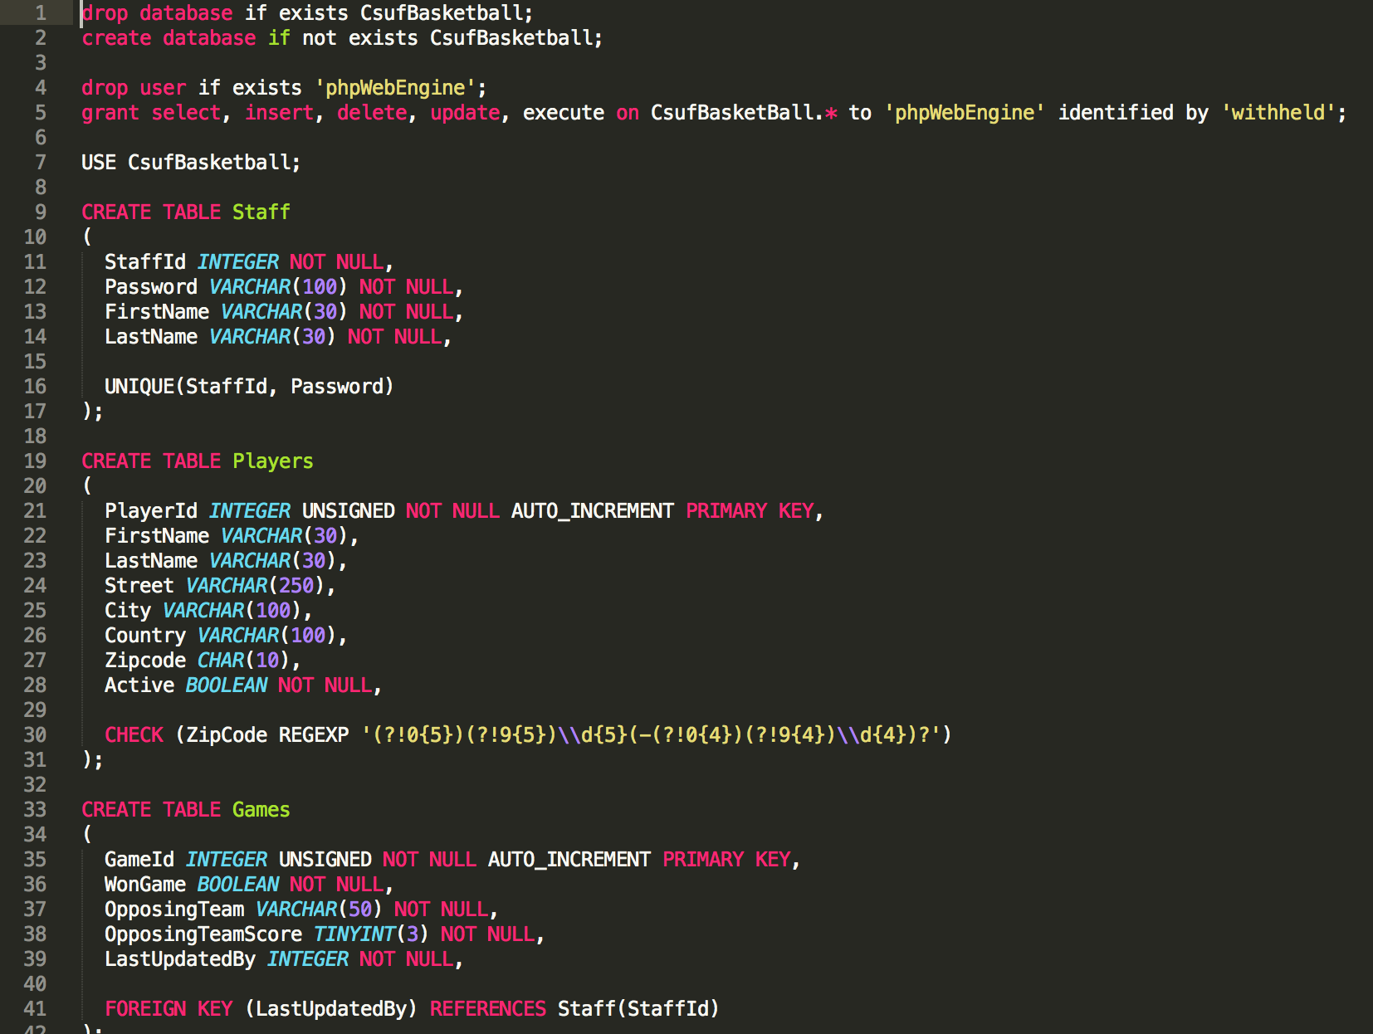
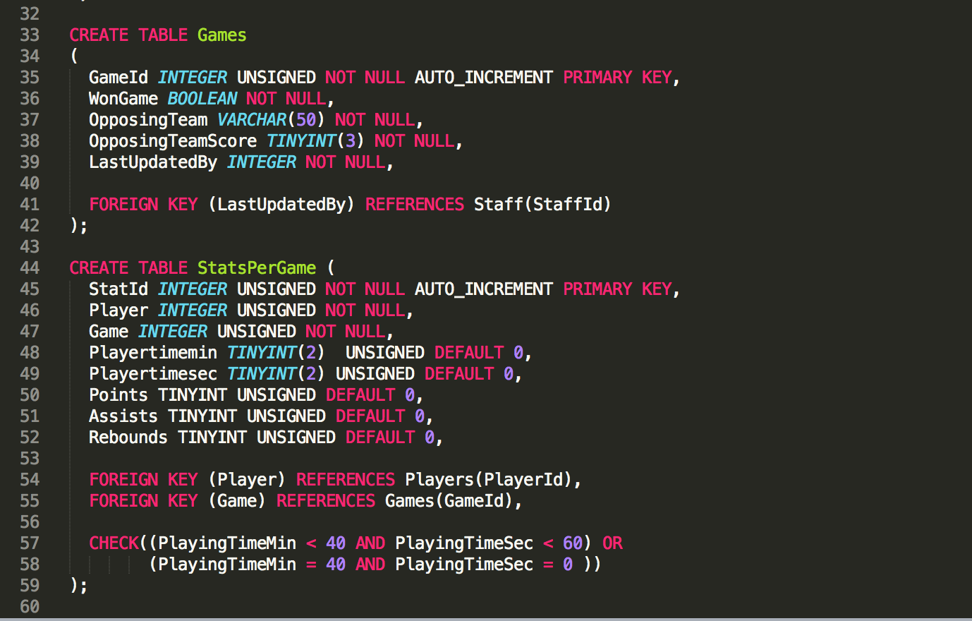
IMPLEMENTATION VIEW

Slide 9
REQUIREMENT VIEW

Slide 10
CONFIGURATION MANAGEMENT VIEW

Slide 11
The End
Thank you!

